Slide 1

Health & Wellbeing Puberty

Slide 2
What are periods?
During puberty, your female reproductive organs start to develop. Each month, these hormones cause an egg to mature and be released from your ovaries.
In case the egg is fertilised by a sperm, the lining of your uterus becomes thick and soft with blood and tissue. If the egg isn’t fertilised, this lining of the uterus isn’t needed so comes away and is released from the body through your vagina.

Slide 3
When will they start?
Girls usually have their first period between the ages of 9 and 14. They will probably be irregular at first, but will settle into a pattern every few months.
If you haven’t started your period by the age of 16, please talk to your GP.

Slide 4
How long will they last?
Most girls will have their period every 28 days or so. The menstrual cycle normally lasts about 28 days, which means there are 28 days between the start of your last period and the start of your next period. It’s very common for periods to be more or less frequent than this though.
Your period can last between three and eight days, usually lasting for about five days. The bleeding will be heaviest in the first couple of days before it starts to slow down towards the end of your period.

Slide 5
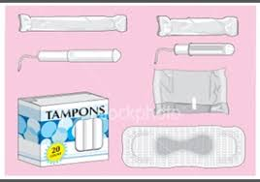
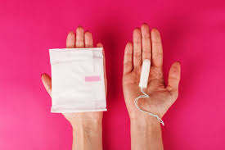
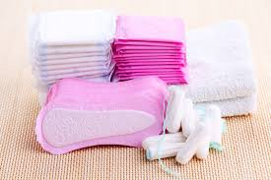
Sanitary products available
Sanitary products are used to soak up and collect the blood you release during your period. The three main types of sanitary products are:
Sanitary pads– these strips of padding have one side that is sticky that you attach to your underwear and another side that is absorbent to soak up the blood. They are available in different sizes to suit how heavy or light your period is.

Slide 6
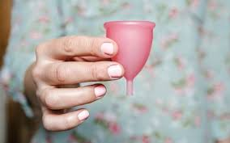
Sanitary products available
Tampons– these are small tubes of cotton wool that you insert into your vagina to soak up the blood. All tampons come with instructions on how to use them as you shouldn’t be able to feel it if inserted correctly.
Menstrual cups– these are cups made from silicone which you put inside your vagina to collect the blood, rather than absorb it. After your period, you can wash a menstrual cup and use it again, unlike sanitary pads and tampons.

Slide 7
PMS Pre-menstrual Syndrome
Changes in your body's hormone levels before your period can cause physical and emotional changes. This is known as PMS (premenstrual syndrome) or PMT (premenstrual tension). There are many possible symptoms of PMS, but typical symptoms include:
feeling bloated/ breast tenderness/ mood swings/ feeling irritable/ spotty skin or greasy hair
These symptoms usually improve when your period starts and disappear a few days afterwards. Not all women who have periods get PMS.

Slide 8
Facts or Myths!
Myth: Girls should rest during their period and avoid exercise
If you feel like exercising, there’s no reason why you shouldn’t. It's actually a great way of controlling PMS symptoms and menstrual cramps because it increases the supply of oxygen to your muscles.
Myth: Girls must see a doctor after their first period
Unless there is a problem like severe pain or bleeding, you probably do not need to see a gynaecologist or doctor.

Slide 9
Facts or Myths!
Myth: Periods should last for exactly one week
Everyone’s period is different. It's perfectly natural for a period to last anywhere between three to seven days. A period may be irregular, especially when it first begins.
Myth: Premenstrual syndrome (PMS) is all in the mind
PMS symptoms are related to the way girls hormones change through their monthly cycle. Symptoms can be emotional (like irritability, depression or fatigue, and physical (cramps or headaches).

Slide 10
Support at Crown Hills
Where can you find sanitary products?
Mrs Dawson – Health and Wellbeing leader – XU13
All female PE teachers and PE changing rooms
All Head of Year bases
The office - reception
Reflection
School nurse – medical room
Expressive arts rooms

Slide 11
Changing your mind set!
The average girl, takes 3 days off per term because of period related issues.
52% of girls say they will miss school because of their period and that periods have held them back from achieving their ambitions and goals.
46% of girls deliberately skip PE lessons due to period anxiety…
But all of these shouldn’t be the case…

Slide 12
Changing your mind set!
How can exercise HELP….
Increases endorphins
Improves your mood
Eases menstrual cramps
Reduces cravings
Keeps your hormones in balance
Helps to regulate irregular periods naturally

