Slide 1
Why BRETTOW?
“We want every student to be the best they can be, thrive in the best possible career and contribute positively to society.” ​
We need a new, additional rewards system that celebrates students personal development, alongside commitment and attendance.
We want to reward students for what they do outside of the curriculum, such as taking on volunteering roles, completing extra curricular activities, leadership roles, entering competitions and attending a wide range of trips.

Slide 2
What is BRETTOW?
Be Ready To Take On The World
The Brettow Awards are designed to recognise and celebrate student successes as independent, self-reliant and dedicated citizens who are charitable, healthy leaders, who aspire to great things, are globally aware and who contribute positively to the school and its community​.
There are 5 Brettow units to complete.

Slide 3
How does BRETTOW work?
Within each unit there are 3 Brettow tasks to be completed in order to achieve a Bronze, Silver and Gold award.
Students can achieve a Bronze Medal by completing all Bronze sections first.
Students work independently to provide evidence for each task within a unit (hard copy or online).
Rewards are celebrated termly as part of the rewards assembly and with an additional end of year celebration.

Slide 4
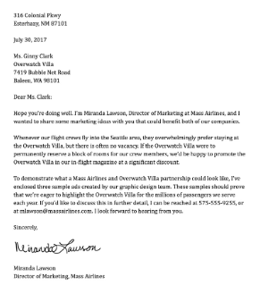
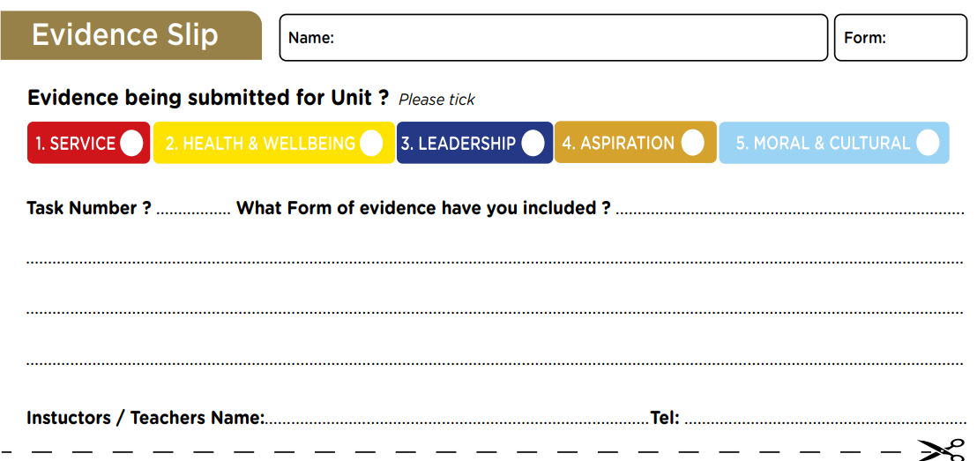
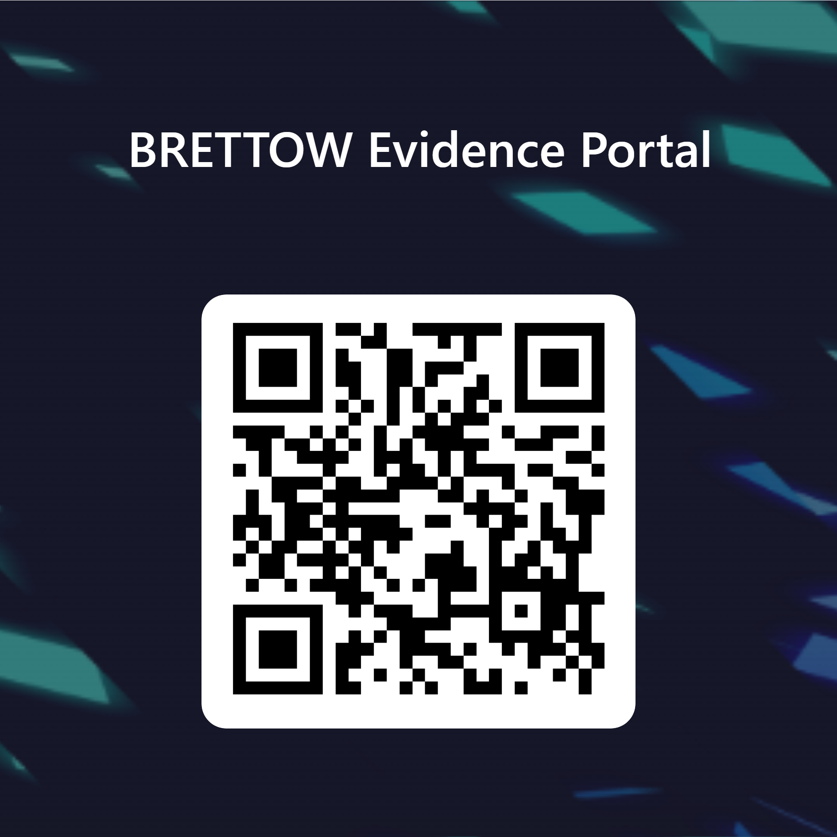
Providing evidence
Students will need to submit their Brettow Award Passport along with their ‘evidence’ and ‘evidence slip’ (inserted in the Passport).
Each Head of Year will have a Brettow Box for submitting the Passport and evidence – students must ensure that their name and form is clearly written on each document and placed in the folder provided.
Alternatively, evidence can be submitted online on Teams where students can upload evidence electronically. They will still need to submit their Passport in the box so that it can be updated.
https://forms.office.com/e/tZjkgEAK5T

Slide 5
Examples of evidence
Forms of evidence can include but are not limited to:
• Photograph of student completing the activity or event (with parental permission)
• Written evidence of participation and signed by the teacher/instructor (to include contact details)
• Example of supporting evidence i.e. poster or leaflet
• Logged time sheet which is signed and approved by teacher/instructor (full name and contact details if someone outside of school i.e. boxing instructor)
Brettow evidence forms will be available as inserts in the Passport to assist with this process.
Pupil Premium students are able to receive funds to support tasks where required, for example with bus/travel costs to the museum.

Slide 6
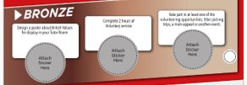
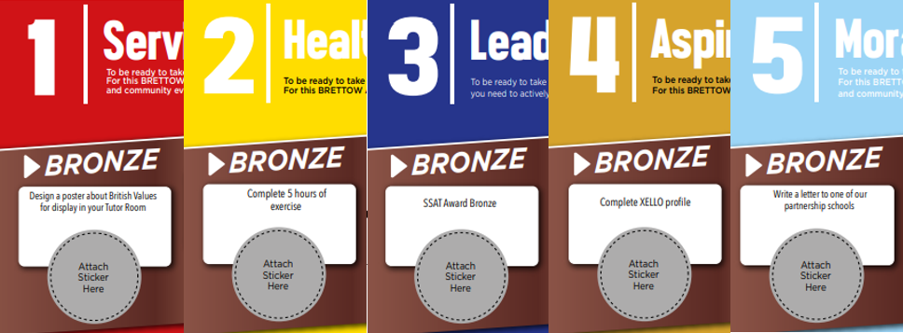
What are the BRETTOW Awards?
Completion of 1 task:
1 x sticker in book = certificate and postcard home
Completion of 3 tasks:
3 x stickers = pin badge, certificate – Bronze, Silver of Gold, letter home
Completion of all Bronze, Silver or Gold units:
Medal, certificate, personal hand written letter home from the Principal. Student Leadership Accreditation.
Rewards are celebrated termly as part of the rewards assembly and with an additional end of year celebration.
To qualify for entrance to the end of year activity (possible options to include Jonny Custard, Boost, Cinema, Tree Top Golf, BBQ etc.)
students must complete a minimum of 9 tasks (9 stickers) from any units per academic year.

Slide 7
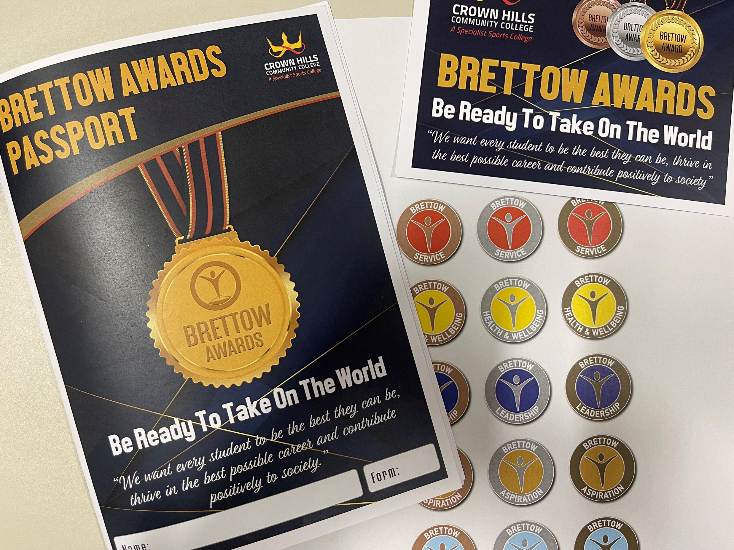
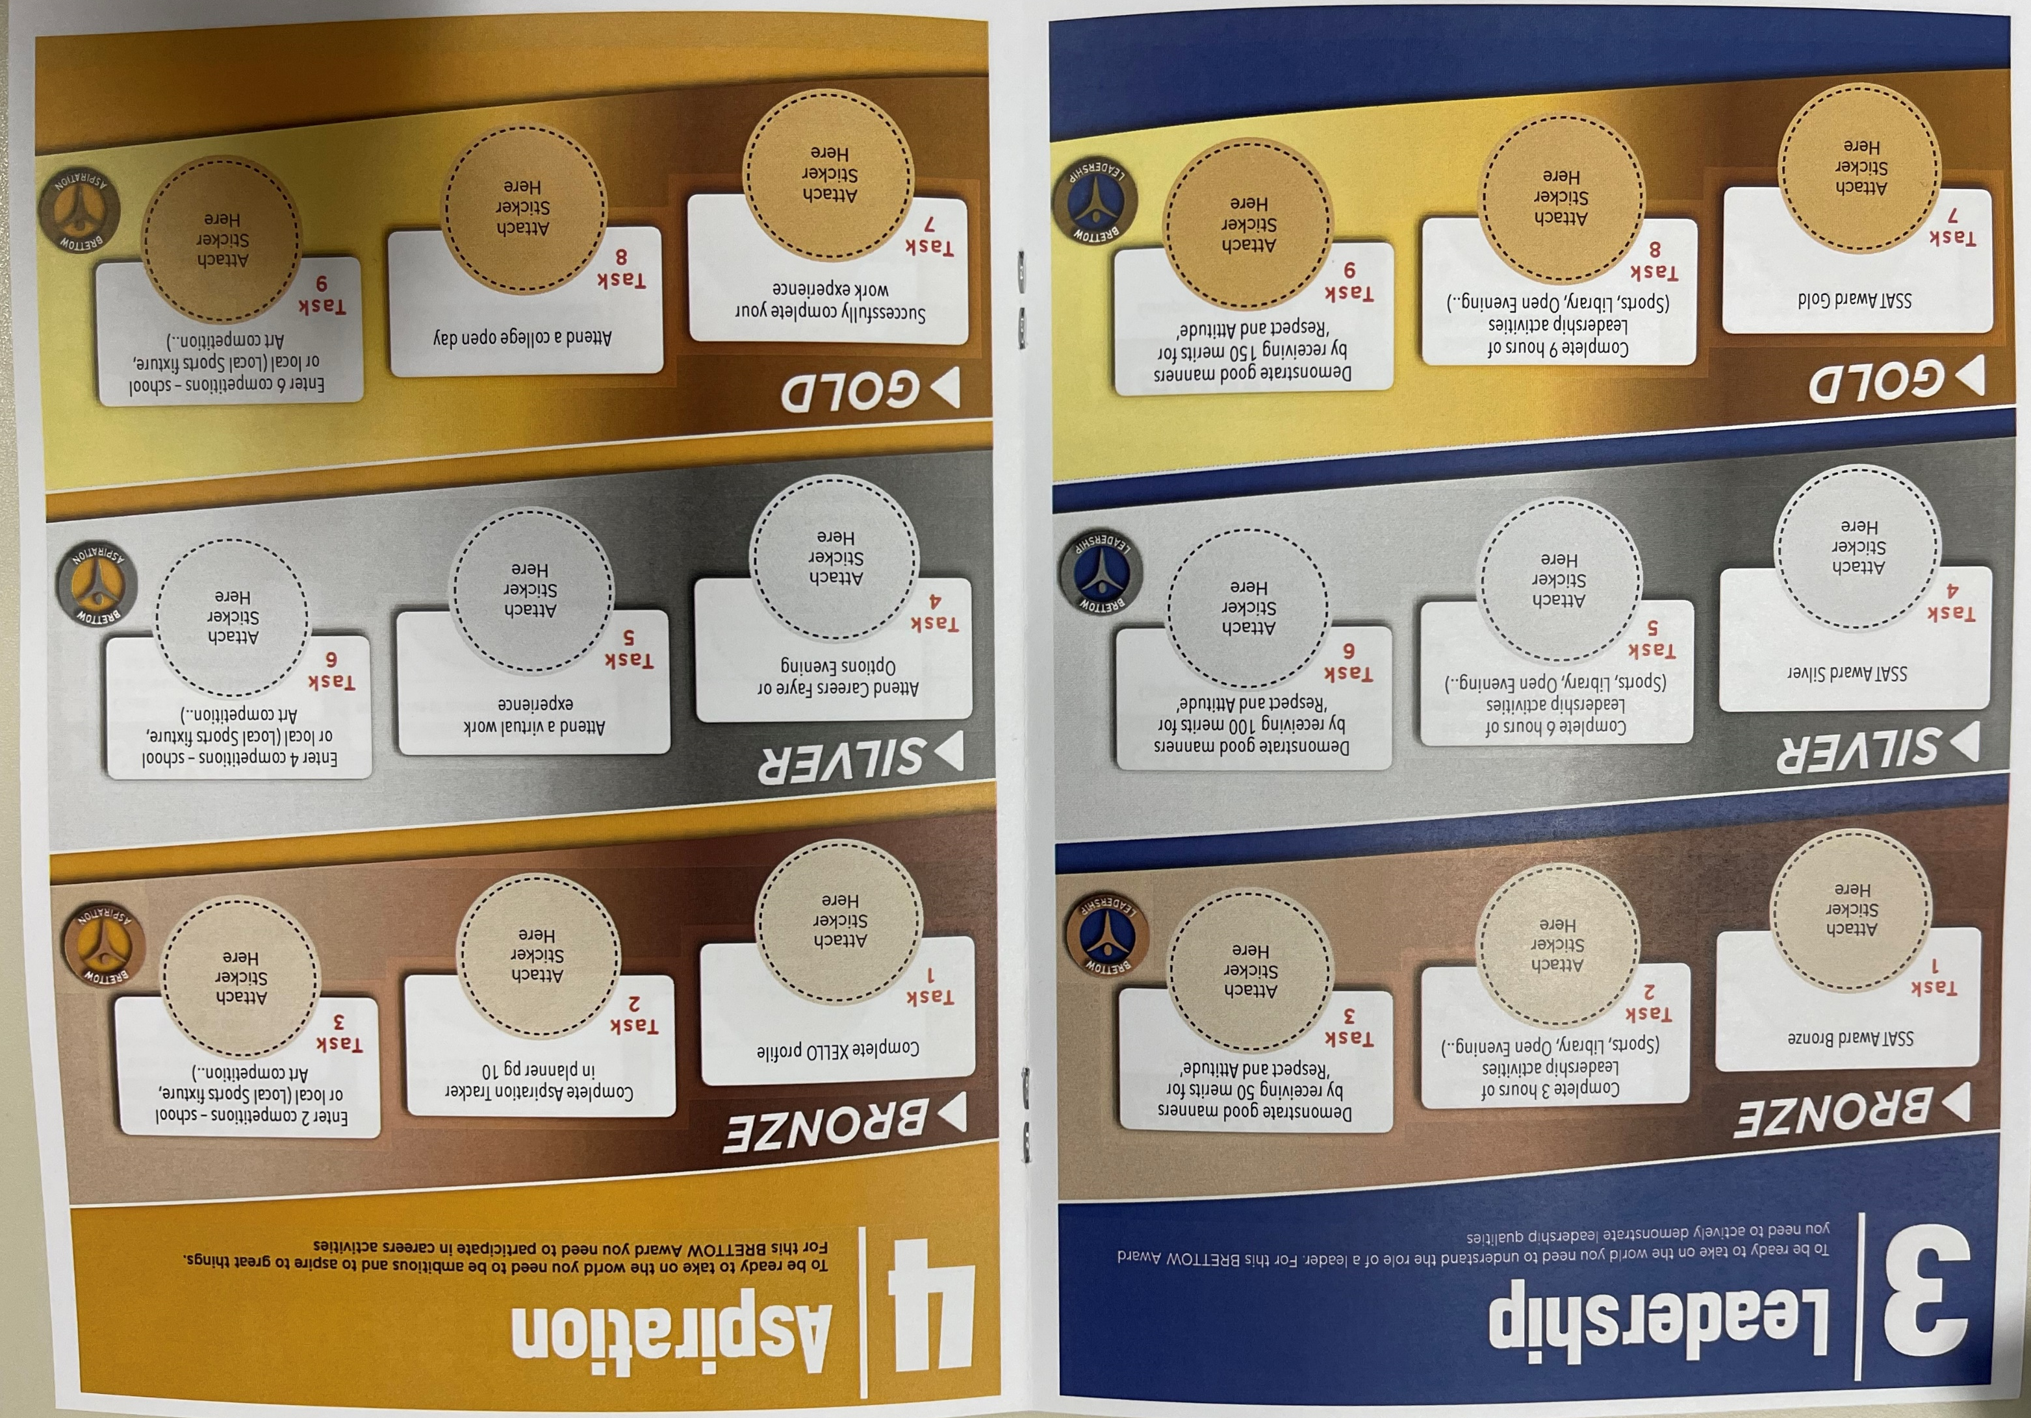

Slide 8
Evidence support sheet displayed in classrooms and online
1. Service - To be ready to take on the world you need to understand how to contribute positively to society. For this BRETTOW Award you need to play an active role as a volunteer by supporting charity and community events
Bronze | Silver | Gold | Supporting Evidence
Task 2 Complete 2 hours of Voluntary service | Task 5 Complete 4 hours of Voluntary service | Task 8 Complete 6 hours of Voluntary service | Volunteering must be completed independently out of school. You could ask to volunteer at a local community centre such as Wesley Hall or Highfields Centre. You could volunteer at a charity shop or help your training coach at your boxing or basketball club. A full list of volunteering ideas are available on the Brettow page on the school website. You can use the Brettow Time Sheet to log the hours completed and ask for it to be signed by the person in charge (their contact details must also be included).
Notes:
2 x posters in all rooms which explain process and provide examples of how to complete tasks
Brettow will be added to tutor program and rewards program

